Slide 1
REVISED UNIVERSAL SOIL LOSS EQUATION-Version 2
RUSLE2
Predicting Soil Erosion By Water: A Guide to Conservation Planning

Slide 2
UNIT 1
Course Objectives and Topics

Slide 3
OBJECTIVES
Understand erosion processes
Learn RUSLE2 and its software
Learn field office applications of RUSLE2

Slide 4
UNIT 2
Overview of Erosion

Slide 5
OVERVIEW OF EROSION
Definition of erosion
Erosion processes
Types of erosion
Why erosion is a concern
Uses of erosion prediction tools

Slide 6
EROSION
“Erosion is a process of detachment and transport of soil particles by erosive agents.”
  Ellison, 1944
Erosive Agents
  Raindrop impact
  Overland flow surface runoff from rainfall

Slide 7
DETACHMENT
Separation of soil particles from soil surface
Adds to the sediment load
  Sediment load: Rate sediment is transported downslope by runoff

Slide 8
DETACHMENT
Detachment
Sediment Load
Sediment Transport
Soil
Notes:
Detachment is the removal of sediment from the soil.
Detachment adds sediment to the sediment load.
Sediment load is the amount of soil being transported.

Slide 9
DEPOSITION
Reduces the sediment load
Adds to the soil mass
Local deposition
  Surface roughness depressions
  Row middles
Remote deposition
  Concave slope
  Strips
  Terraces
Notes:
Deposition is the transfer of sediment from the sediment load to the soil surface.
Deposition reduces sediment load.
Sediment can be deposited immediately near where it is detached. This deposition is called local deposition. Examples of local deposition include deposition in depressions and row middles.
Sediment can also be deposited at some distance (10’s of feet) from where it was detached. This deposition is known as remote deposition. Examples of this deposition is deposition on concave slopes, at the upper edge of grass strips, and in terrace channels and impoundments.

Slide 10
DEPOSITION
Sediment Load
Sediment Transport
Deposition
Soil
Notes:
The amount of sediment being transported is known as sediment load.
Deposition is the transfer of sediment from the sediment load to the soil surface.
Deposition causes sediment load to decreases and sediment to accumulate on the soil surface.

Slide 11
TYPES OF EROSION
Interrill and rill (sheet-rill)
Ephemeral gully
Permanent, incised (classical) gully
Stream channel
Mass movement
Geologic
Notes:
RUSLE2 estimates interrill and rill erosion, sometimes referred to as sheet-rill erosion. Other procedures must be used to estimate the other types of erosion.
Ephemeral gullies reoccur in the same location, rills are parallel and generally do not reoccur in the same location.

Slide 12
DEFINITIONS
Simple Uniform Slope
SOIL LOSS
SEDIMENT
YIELD
RUSLE2
ESTIMATES
TO HERE
Notes:
The simplest application of RUSLE2 is to assume a simple uniform slope. RUSLE2 estimates the amount of sediment leaving the slope length assumed in the RUSLE2 computation.
Soil loss is the net mass of sediment removed from a particular portion of the slope.
In this simple uniform slope, sediment yield, which is the amount of sediment delivered to the end of the slope equals soil loss. If deposition, like the deposition that occurs on concave slopes had occurred, sediment yield would have been less than soil loss.
Soil loss is expressed in unit of mass divided by the area that produced the soil loss.

Slide 13
DEFINITIONS
Complex Slope
Soil loss
Remote deposition
Sediment yield
Notes:
This complex slope has a concave section where deposition occurs. The portion of the slope from the beginning of the slope to where deposition begins is the eroding portion of the slope.
Soil loss occurs on the eroding portion of the slope. It is this soil loss that would be used in conservation planning to protect this hillslope from excessive erosion.
Sediment yield is less than soil loss because of the deposition.
Sediment Yield = Soil Loss - Deposition
The deposition that occurs on this slope is remote deposition because it occurs some distance from where the sediment was detached.

Slide 14
DEFINITIONS
Complex Slope
Soil loss
Remote deposition
Soil loss
Sediment yield
Notes:
Some times complex slopes have a flat section in the middle of them that causes deposition. This deposition is also remote deposition because it occurs some distance from where the sediment was detached.
Soil loss occurs at to two locations on the slope, one on the upper end of the slope and one on the lower portion of the slope.
RUSLE2 can estimate soil on both sections of the slope and it computes the deposition that occurs in the middle of the slope.
Applying RUSLE2 to compute soil loss on the upper of the slope is the same as applying RUSLE2 to a simple slope.
Soil loss on the lower portion of the slope depends on runoff that originates over the entire slope length.
Sediment yield (sediment delivery) for this slope is also less than soil loss because of deposition.
Sediment yield= Soil loss - Deposition

Slide 15
DEFINITIONS
Strips
Soil loss
Remote deposition
Soil loss
Remote deposition
Soil loss
Sediment yield
Notes:
This slide illustrates the deposition that is caused by dense strips of grass. This deposition is remote deposition because it occurs some distance from where the sediment was detached.
Soil loss also occurs at several locations on the slope. Even though deposition occurs, the surface runoff continue through the depositional area. Soil loss on the lower part of the slope depends on runoff that originated from the very upper end of the slope.
Two distinct rates of soil loss occur on this slope.
A high soil loss occurs on the the “clean-tilled” area and a low soil loss occurs in the grass strips below where deposition ends within the strips.
Sediment Yield = Soil Loss - Deposition

Slide 16
DEFINITIONS
Terraces
Remote deposition
Remote deposition
Soil loss
Soil loss
Soil loss
Remote deposition
Sediment yield
Notes:
This slide illustrates the remote deposition that occurs with a terrace system.
Soil loss occurs on the inter-terrace interval.
Soil loss on the inter-terrace interval is less than soil loss without the terraces because terraces shorten up the slope length. Runoff on the lower inter-terrace interval originates at the next terrace upslope, not from the very top of the hillslope.
The deposition that occurs in the terrace channels is remote deposition because the location of the deposition is some distance from where the sediment was detached. Also, the deposition is concentrated in a much smaller area than the area that produced the sediment.
Sediment Yield = Soil Loss from Inter-terrace interval – Deposition in terrace

Slide 17
LOCAL DEPOSITION
Random Roughness
Ridges-Furrows
Notes:
Deposition in depressions formed by random roughness and in furrows between ridges is local deposition.
The deposition occurs very near to the location where the detachment occurred.
The area of deposition is comparable to the area of detachment.
The deposition is widespread over the entire slope rather than being concentrated in relatively small downslope areas.
The detachment computed by RUSLE2 is actually the net of local detachment and local deposition. That is, RUSLE2 does not explicitly compute local deposition, but RUSLE2 explicitly computes remote deposition.
Oriented roughness, such as ridging, may also cause local deposition.

Slide 18
Credit for Deposition
Local Deposition
Full credit
Remote Deposition
Partial credit
Amount
Location
Spacing of terraces
Notes:
Full credit as soil saved is give to local deposition because it is widely dispersed over the hillslope.
Full credit is taken for local deposition even though it does enrich the soil surface in coarse particles.
Only partial credit is taken for remote deposition because it is concentrated in relatively small areas away from the sediment source.
Deposition at the lower end of a concave slope does nothing for maintaining the upper part of the slope. Even though sediment is deposited at the lower end of the slope, the upper part of the slope is permanently degraded by erosion.
When sediment is trapped up the slope, tillage tends to respread the deposited sediment some that benefit of this deposition is realized, especially for lower portions of the slope.
Thus, the credit given for deposition depends on the amount and location of the deposition.
In the case of terrace, the credit also depends on spacing of the terraces. The credit is reduced as terrace spacing becomes wide.

Slide 19
SEDIMENT CHARACTERISTICS
Particle Classes
  Primary clay, primary silt, small aggregate, large aggregate, primary sand
At Detachment
  Distribution of classes function of texture
  Diameter of small and large aggregates function of texture
After Deposition
  Sediment enriched in fines
Notes:
Sediment is a mixture of primary particles and aggregates.
Soil texture plays the major role in determining the sediment characteristics at the point of detachment. The effect of soil texture on sediment characteristics at the point of detachment is considered by RUSLE2.
High quality soil management that improves soil aggregates also affects sediment characteristics at the point of detachment, but that effect is not considered by RUSLE2.
RUSLE2 computes how deposition enriches the sediment in fines.

Slide 20
EROSION IS A CONCERN
Degrades soil resource
  Reduces soil productivity
  Reduces soil organic matter
  Removes plant nutrients
Causes downstream sedimentation
Produces sediment which is a pollutant
Produces sediment that carries pollutants
Notes:
Some of the reasons why we are concerned about erosion.

Slide 21
WHERE EROSION CAN BE A PROBLEM
Low residue crops
Conventional tillage
Rows up/down steep slopes
Low maintenance pasture
Disturbed land with little cover
Notes:
Situations where erosion is likely to be greatest. In general, erosion is greatest is vegetative cover, including residue from last’s year crop, is low and where operations are directly up and down slope.

Slide 22
EROSION PREDICTION AS A TOOL
Guide management decisions
Evaluate impact of erosion
Inventory soil erosion
Conservation planning
Notes:
The principal use of erosion has been a tool to guide conservation planning.
It has also been a major tool used to estimate soil loss in the USDA-NRI inventories.
Erosion prediction tools have been used for Inventories i.e. NRI since 1967.

Slide 23
EROSION PREDICTION AS A TOOL
Concept:
  Estimate erosion rate
  Evaluate by ranking
  Evaluate against quality criteria
Tool: RUSLE2
Quality Criteria: Soil loss tolerance
Notes:
Generally for conservation planning the quality criteria is T (Tolerable Soil Loss) but other quality criteria may be used for planning due to offsite damages, or water quality concerns etc..

Slide 24
PLANNING VARIABLES
Soil loss on eroding portions of hillslope
Detachment (sediment production) on hillslope
Conservation planning soil loss for hillslope
Ratio of segment soil loss to soil tolerance adjusted for segment position
Sediment yield from hillslope/terraces
Enrichment ratio
Notes:
RUSLE2 computes values for several variables of use in conservation planning, depending on the planning objectives.
Soil loss on the eroding portions of the hillslope provides soil loss values to compare to soil loss tolerance to select erosion control practices to protect the hillslope from degradation by excessive erosion.
Detachment the average sediment production rate for the hillslope. It is the average of the soil loss on the averages where soil loss is high along with the areas, like in grass strips, where sediment production is low.
Conservation planning soil loss is the detachment for the slope less credit given for deposition, keeping mind that credit for deposition depends on amount, location, and spacing of terraces.
Sediment yield is the amount of sediment that leaves the hillslope represented in RUSLE2. Because most hillslopes used in RUSLE2 do not go to the edge of the field, this value is generally not a sediment yield value to edge of field.
RUSLE2 can compute soil loss, deposition, and sediment yield from irregular hillslopes by the hillslopes being divided into segments. The proper comparison of soil loss to soil loss tolerance for a hillslope segment requires that the soil loss tolerance value be adjusted based on position of the segment on the hillslope. RUSLE2 makes that adjustment and computes the ratio of soil loss to adjusted T value by segment so that the proper mathematical comparison can be made.

Slide 25
UNIT 3
Overview of RUSLE2

Slide 26
OVERVIEW OF RUSLE2
(Revised Universal Soil Loss Equation-Version 2)
Where RUSLE2 applies
Major factors affecting erosion
RUSLE2 factors
RUSLE2 background

Slide 27
Landscape
RUSLE2 Area
Overland flow
Interrill
Rill
Ephemeral
Gully (Concentrated flow)
Erosion Types
Notes:
This slide shows the portion of the landscape where interrill-rill (sheet) erosion may occur.
The dashed lines on the left show the RUSLE area that is depicted in the upper right hand corner of the screen and the dashed line on the left side represents a subwatershed divide for a the two concentrated flow watersheds.

Slide 28
FACTORS AFFECTING INTERILL-RILL EROSION
Climate
Soil
Topography
Land use
  Cultural (cover-management) practices
  Supporting practices
Notes:
Erosion is greatest where rainfall amount and intensity are highest.
Some soils are naturally more erodible than are other soils.
Steep and long slopes produce more erosion than do short and flat slopes.
Land use has a huge effect on erosion. Exposing the soil to raindrop and surface runoff dramatically increases erosion.

Slide 29
RUSLE2 FACTORS
Daily Soil Loss a = r k l s c p
Daily Factors
r - Rainfall/Runoff
k - Soil erodibility
l - Slope length
s - Slope steepness
c - Cover-management
p - Supporting practices
Average annual soil loss = sum of daily soil loss values
Different formulation from USLE and RUSLE1
Notes:
The USLE computed soil loss by A=RKLSCP, where an average annual value was computed for each factor. With the exception of the interaction between the R factor and the C factor, not interaction between the USLE factors were considered. The temporal scale used in computing the C factor was a crop stage period over which cover-management conditions were assumed to be represented by an average value for the period. The length of crop stage periods typically ranged from a few days, like the rough plowed period in the spring, to a few months, like the after harvest period over the late fall, winter, and early spring.
RUSLE1 considered additional interactions of the K and R factors and a partial interaction between P and R. Also, the temporal time scale used in RUSLE1 was half month, and less if an operation occurred within a half month. This approach allowed a “paper version” of RUSLE1 to be used.
However, while the mathematical techniques used in USLE and RUSLE1 were powerful and allowed paper versions, they were mathematically inaccurate by about 15 to 20% in several situations. The proper mathematical procedure is to compute a daily value for each factor, compute a daily soil loss value, and add up the daily values to obtain a value for rotation. RUSLE2 uses this mathematical procedure, which is a major change from both the USLE and RUSLE1.
Although RUSLE2 computes an average annual value for the traditional USLE/RUSLE1 factors, those values are not used to compute soil loss. In fact, multiplication of those values, as was done in the USLE and RUSLE1, will not give the RUSLE2 soil loss value. The difference results from the far more proper mathematics in RUSLE2 than in the approximate mathematics in the USLE/RUSLE1.
Small letters, rather than the traditional capitol letters, are used to distinguish the RUSLE2 approach from the USLE/RUSLE1 mathematical approach.
The convention is that upper case letters in the USLE and RUSLE1 indicate average annual values while the lower case letters in RUSLE2 indicate daily values.

Slide 30
RUSLE FACTORS
(Sediment Production)
Climate r
Soil k
Topography ls
Land Use and lscp
Management
Notes:
In agricultural situtations, climate, soil, and topography are determined by the location and are fixed. However, ls can be changed by installing terraces.
On severely disturbed areas, both soil and topography can be changed.
The most important consideration in conservation planning and the factor that has the single greatest effect on soil loss is land use, management, and the use of supporting practices like contouring.
C also affects soil by changes in organic matter, random roughness and consolidation.

Slide 31
RUSLE FACTORS
A = f (erodibility, erosivity)
    Erosivity – rklscp
    Erodibility - klc
Notes:
Erosivity is a measure of the forces actually applied to the soil by the erosive agents of raindrop impact, waterdrops falling from plant canopy, and surface runoff.
Erosivity has two parts. The inherent erosivity determined by the rainfall at a location and the infiltration of the soil based on inherent soil properties. The other part of erosivity is the part that management can change such as changes in infiltration that affects rate and amount of runoff and the present of material that reduces the forces applied to the soil.
Erodibility is a measure of the susceptibility(inverse of resistance) of the soil to erosion. Erodibility has two parts, the inherent erodibility of the soil and the part of the erodibility that can be influenced by management.
Notice that most RUSLE2 factors contain both an erosivity effect and an erodibility effect.
Erosivity is a function of climate and management.

Slide 32
RUSLE FACTORS
(Keep in mind that RUSLE2 operates on a daily basis)
Unit Plot Concept
a = rk lscp
rk - Unit plot soil loss
(dimensions)
lscp - Adjusts unit plot soil loss
(dimensionless)
Notes:
The unit plot provides a standard and reference condition to define and determine values for soil erodibility factor.
The unit plot condition is a reference condition for all of the other RUSLE2 factors. A value for another RUSLE2 factor besides r or k is the ratio of soil loss for the given condition to the soil loss from the reference condition of the unit plot.
The starting in RUSLE2 is the product of rk, which gives a soil loss value for the reference unit plot condition. The other factors adjust for the difference between field conditions and the reference unit plot condition.
Tons/Acre/Year from a specific slope (L)
Unit Plot = 72.6’ and 9%
R is computed from weather records
K is a measure of erodibility for a CONTINUOUS CULTIVATED
FALLOW condition.
L (72.6’) = 1
S (9%) = 1
C ( CONTINUOUS CULTIVATED FALLOW) = 1
P (UP & DOWN) = 1
RUSLE estimates erosion when there are adjustments to the unit plot.

Slide 33
Relation of deposition to transport capacity and sediment load on a complex slope
Hillslope
Transport capacity
Transport capacity = sediment load
Sediment load
Sediment production less than transport capacity
Deposition
Deposition because sediment production exceeds transport capacity
Notes:
This slide illustrates the interaction of transport capacity, sediment load, sediment production, and deposition on a complex slope.
Main points:
If transport capacity exceeds sediment load, sediment load will be determined by the amount of sediment made available by detachment.
If sediment load exceeds the amount of sediment produced by detachment, deposition occurs.
If the sediment load exceeds transport capacity because of a decrease in transport capacity, deposition occurs which reduces sediment load.
When deposition occurs, sediment loads “lags” transport capacity depending on the fineness of the sediment.
Deposition is a selective process where the coarse particles are deposited leaving the sediment load enriched in fines.
In this illustration, local deposition occurs on the very flat portion of the hillslope because interrill erosion produces more sediment than the flow can transport.
Deposition occurs on the lower end of the slope because of a decrease in transport capacity because of a flattening of the slope. Deposition begins to occur where transport capacity equals sediment load. Deposition does not necessarily begin to occur just where transport capacity begins to decease.

Slide 34
Relationship of Deposition to Transport Capacity and Sediment Load for a Grass Strip
Transport capacity
Deposition region
Deposition ends where transport capacity = sediment load
Sediment load
Erodible soil surface
Dense grass
Notes:
This slide illustrates how RUSLE2 computes deposition for a grass strip. The strip causes an abrupt decrease in transports capacity at the upper edge of the strip.
After the abrupt decrease, transport capacity increases within the strip.
Deposition occurs because transport capacity drops to less than sediment load.
If the strip is sufficiently wide, deposition will end within the strip where sediment load becomes equal to transport capacity.

Slide 35
How Deposition at a Grass Strip Affects Sediment Characteristics
Particle class | Before (%) | After (%)
Primary clay | 5 | 22
Primary silt | 24 | 58
Small aggreg. | 36 | 14
Large aggreg. | 24 | 5
Primary sand | 7 | 1
SDR = 0.2
Note how deposition enriches sediment in fines
Notes:
This slide illustrates how deposition enriches the sediment in fines.
The enrichment would have been greater if the sediment delivery ratio had been smaller.
The greater the percentage of deposition, the greater the enrichment.
This slide also illustrates the particle classes used in RUSLE2.

Slide 36
RUSLE2 BACKGROUND
Combines empirical field data-process based equations
(natural runoff and rainfall simulator plots)
    Zingg’s equation (1940)
    Smith and Whit’s equation (1947)
    AH-282 (1965)
    “Undisturbed land” (1975)
    AH-537 (1978)
    Disturbed forestland (1980)
    RUSLE1 (1992)
    AH703 (1997)
    OSM Manual (mined, reclaimed land, construction sites) (1998)
    RUSLE2 (2001)
Notes:
RUSLE2 has evolved from a series of previous erosion prediction technologies. The USLE was entirely an empirically based equation and was limited in its application to conditions where experimental data were available for deriving factor values.
A major advancement in RUSLE1 was the use of subfactor relationships to compute C factor values from basis features of cover-management systems, which allowed RUSLE2 to be applied tofar more conditions than the USLE. While RUSLE1 retained the basic structure of the USLE, process-based relationships were added where empirical data and relationships were inadequate, such as computing the effect of strip cropping for modern conservation tillage systems.
RUSLE2 is another major advancement over RUSLE2. While RUSLE2 uses the USLE basic formulation of the unit plot, the mathematics of RUSLE2 are on a daily basis. Subfactor relationships are also used in RUSLE2 but these relationships have been improved from RUSLE1, a new ridge subfactor has been added, and the deposition equations have been extended to consider sediment characteristics and how deposition changes these characteristics. It includes new relationships for handling residue, including resurfacing of residue by implements like field cultivators.
The major change visible change in RUSLE2 is its new, modern graphical user interface that is easy to use, but is extremely powerful in the information that it displays and the types of situations that it can represent. RUSLE2 is a vary powerful model yet it uses very simple, easy to obtain inputs.
RUSLE2 computes both temporal and spatially variable effects such as the effect of soil and management varying along a hillslope.
The RUSLE2 developers claim that it is the best available technology for conservation planning at the local field office level. Its science is totally modern and is just as process-based as any other model and includes new science not available in any other model.
RUSLE2 brings together of the empirically based models like the USLE/RUSLE1 and the process based models like WEPP.
RUSLE2 does not compute ephemeral gully erosion at present, but capability is being planned for RUSLE2. RUSLE2 will be the erosion prediction tool of choice for the next several years.
.

Slide 37
RUSLE2 APPLICATIONS
Cropland
Pastureland
Rangeland
Disturbed forest land
Construction sites
Surface mine reclamation
Military training lands
Parks
Waste disposal/landfills

Slide 38
SUMMARY
Factors affecting erosion
RUSLE2 factors
RUSLE2 background

Slide 39
Unit 4
RUSLE2 Factors

Slide 40
RUSLE2 Factors
(Keep in mind that factors are on a daily basis)
r- erosivity factor
k- erodibility factor
l- slope length factor
s- slope steepness factor
c- cover-management factor
p- supporting practices factor
Notes:
The next few slides will give a brief overview of RUSLE.

Slide 41
EROSIVITY
Single storm
  Energy x 30 minute intensity
  Fundamentally product of rainfall amount x intensity
Annual-sum of daily values
Average annual-average of annual values
Daily value=average annual x fraction that occurs on a given day
Notes:
The core part of RUSLE2 is that it estimates soil loss from an individual storm.
The linear relationship between erodibility and soil erodibility allow simple mathematical approaches to integrate the variables over time.

Slide 42
EROSIVITY - R
Measure of erosivity of climate at a location
Las Vegas, NV 6
Phoenix, AZ 23
Denver, CO 30
Syracuse, NY 95
Minneapolis, MN 120
Chicago, IL 160
Richmond, VA 200
St. Louis, MO 200
Dallas, TX 270
Birmingham, AL 380
Charleston, SC 400
New Orleans, LA 630
Notes:
Erosivity varies greatly by location. Climate is about 100 times more erosive in New Orleans than in Las Vegas.

Slide 43
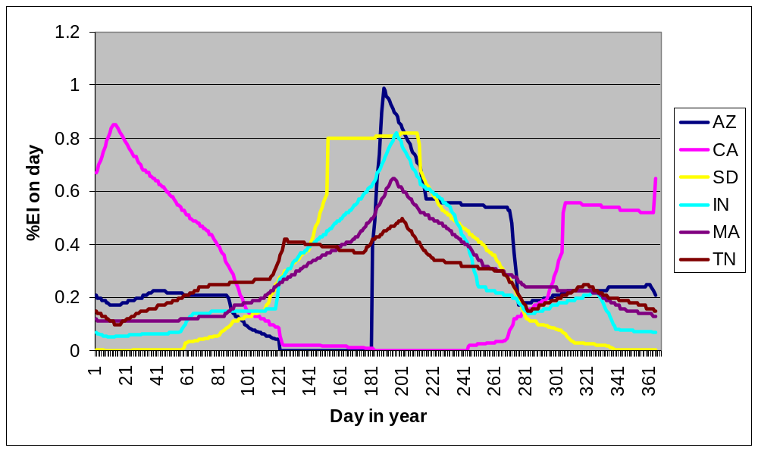
Erosivity Varies During Year

Slide 44
10 yr 24 hr precip
Reflects locations where intense, erosive storms occur that have a greater than proportional share of their effect on erosion
  Effectiveness and failure of contouring
  Effect of ponding on erosivity
  Sediment transport capacity
Notes:
The important rainfall variable for the effect of cover-management practices is cumulative erosivity.
The effect of supporting practices that are strongly influenced by runoff are much more dependent on the effects of a few, major intense storms.
The effect of these few storms is captured in RUSLE2 by use of the10 Yr EI storm.
For example, contouring is less effective in the Southern US than in the Northern US because of intensive storms. Use of the 10 yr 24 hr precip storm in computing the effectiveness of contouring allows RUSLE2 to capture that difference.

Slide 45
Reduction by Ponding
Significant water depth reduces erosivity of raindrop impact
Function of:
  10 yr 24 hr precip
  Land steepness
Notes:
A build of water on the soil surface reduces the erosivity of raindrop impact.
RUSLE2 captures this effect using the variables of 10 yr EI storm and the steepness of the land.
The greatest reduction of ponding is for flat slopes where the 10 yr EI storm is large, like in the lower Mississippi Delta.

Slide 46
SOIL ERODIBILITY - K
Measure of soil erodibility under standard unit plot condition
  72.6 ft long, 9% steep, tilled continuous fallow, up and down hill tillage
Independent of management
Major factors
  Texture, organic matter, structure, permeability (runoff potential)
Notes:
A key point is that soil erodibility is determined under the standard reference condition where management effects have been eliminated by maintaining the unit plots in a continuous tilled, fallow conditions for a number of years.
The K value that is used if for the soil fines, but the influence of rock fragments in the soil profile should be considered in setting K values.
The effects of rock fragments on the soil surface is considered in the cover-management computations.
Do not use a K value that has been adjusted for rock fragments on the soil surface because use of such an adjusted K value can cause a major mathematical error in RUSLE2.
RUSLE2 computes a time varying K value as a function of monthly temperature and rainfall.
In contrast to RUSLE1, the time varying K value can be used throughout the US except in the Northwest Wheat and Range Region (NWRR).

Slide 47
SOIL ERODIBILITY - K
Effect of texture
  clay (0.1 - 0.2) resistant to detachment
  sand (0.05 - 0.15) easily detached, low runoff, large, dense particles not easily transported
  silt loam (0.3 - 0.5) moderately detachable, moderate to high runoff
  silt (0.4 -0.6) easily detached, high runoff, small, easily transported sediment
Notes:
Values shown in parenthesis are typical K factors for those texture groups.

Slide 48
Time Variable K
Varies during year
High when rainfall is high
Low when temperature is high
Very low below about 25 oF
Notes:
The K value is not a pure measure of soil erodibility as an intrinsic soil property.
The K values also includes some erosivity effects by how soil properties affect runoff, which is a significant part of what the variable K is representing.
The same storm occurring in August generally produces less runoff than the same storm occurring in April in a Midwestern location.
The other part of what the variable K represents is that K values are typically high in the spring as and immediately after the soil thaws.

Slide 49
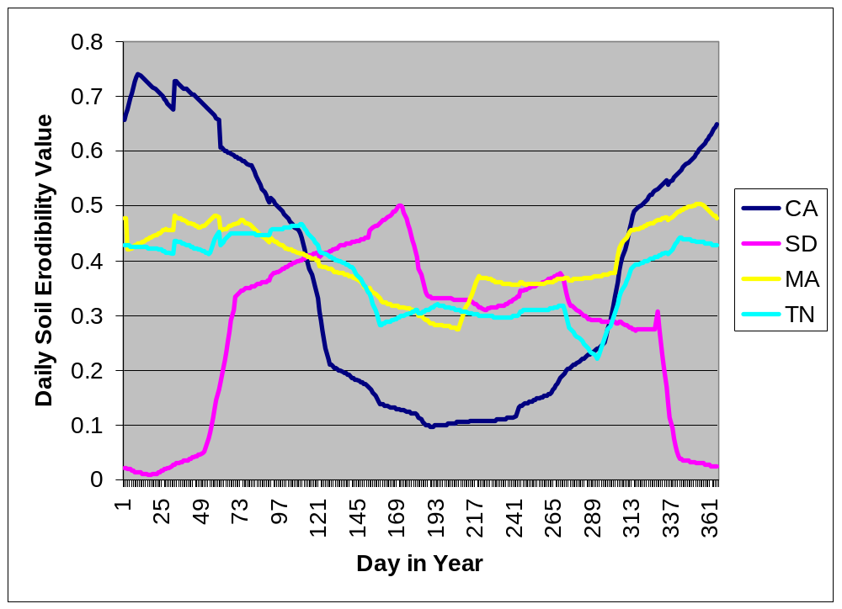
Time Variable K
Base K value = 0.37
Notes:
The variation in K depends on the location.
In particular the variation depends on the sequence of monthly temperature and precipitation at the location.

Slide 50
TOPOGRAPHY
Overland flow path length
Slope lengths for eroding portions of hillslopes
Steepness
Hillslope shape
Notes:
These are the main variables that determine how topography affects erosion.

Slide 51
Hillslope Shape
Convex
Uniform
Concave
Complex-Convex:concave
Complex-Concave:convex
Notes:
These are typical hillslope shapes.
Even though the hillslope is non-uniform, a uniform hillslope is often assumed in RUSLE2 to compute soil loss on the upper eroding portion of the hillslope.
Such as approach is often satisfactory for most conservation planning.
However, in some cases like concave:convex hillslope, the entire hillslope needs to be considered to obtain an accurate soil loss estimate. Even though deposition occurs on the midpart of this hillslope, the entire hillslope length has to be considered because of the origin of the runoff that flows over the lower portion.
RUSLE2 can be used to compute soil loss, deposition, and deposition for each of these slope shapes by dividing the slope into segments.

Slide 52
Overland Flow Path Length
Distance from the origin of overland flow to a concentrated flow area
This length used when the analysis requires that the entire flow path length be considered.
Notes:
The entire slope length is used when the analysis requires that the entire slope length be used.
Examples include computing sediment yield when deposition occurs on the slope or when deposition occurs on the midpart of the slope and the slope length is needed to compute soil loss on the lower part of the slope.
See the next slide for determining slope length when the analysis deals with computing soil loss for the upper part of the slope.

Slide 53
Slope Length for Eroding Portion of Slope
Only works for simple slopes
Traditional definition
  Distance from origin of overland flow to concentrated flow or to where deposition begins
  Definition is flawed for strips and concave:convex slopes
Best approach: Use overland flow path length and examine RUSLE2 segment erosion rate values
Notes:
This approach is the traditional way of applying erosion prediction for conservation planning.
It is still a good method for simple situations.
Sometimes determining where deposition begins is a problem on concave slopes.
RUSLE2 determines that location. The location varies on a daily basis as conditions vary daily.

Slide 54
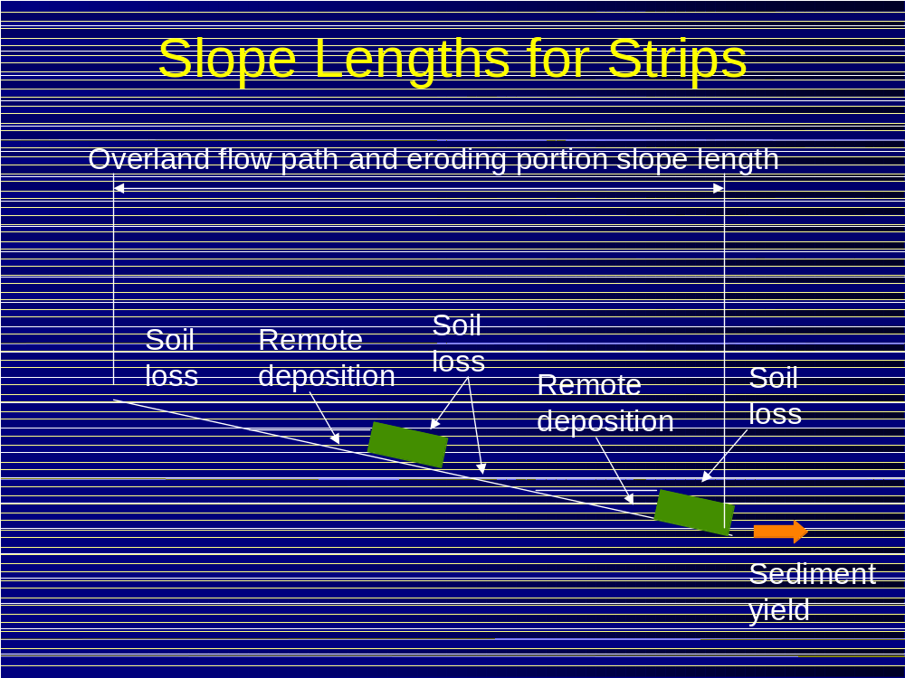
Notes:
Even though deposition occurs on a slope with strips, the entire slope length is used because the runoff that flows over the lower portion of the slope originated at the top of the hillslope slope.
Although deposition occurred, runoff flowed through the depositional area and through the strips to downslope areas.
RUSLE2 computes how increased infiltration in the strips reduces runoff below the strips.

Slide 55
Slope Length for Concave Slope
Overland flow path length
Eroding portion slope length
Deposition
Notes:
This slide illustrates the two major portions of a concave slope that include the upper eroding portion.
A slope length to the upper edge of the deposition area can be used to compute soil loss on the eroding portion of the hillslope.
The entire slope length can be used to compute erosion on the eroding portion, deposition on the depositional portion, and sediment yield and sediment characteristics for the sediment delivered from the slope.

Slide 56
Rule of Thumb for Deposition Beginning on Concave Slopes
Average steepness of concave portion
Example:
Assume average slope of concave section = 10%
½ of 10% is 5%
Deposition begins at location where the steepness is 5%
Deposition begins at location where steepness = ½ average steepness of concave portion
Deposition begins
Notes:
This slide illustrates a way to estimate where deposition occurs.

Slide 57
Slope Length for Concave:Convex Slope
Overland flow path length and slope length for lower eroding portion of slope
Slope length for upper eroding portion of slope
Deposition
Notes:
The slope length to where deposition begins can be used to compute soil loss on the upper eroding portion of slope.
However, the slope length for the lower eroding portion does not begin where deposition ends because of where runoff originates that flows across the lower portion.
The entire slope length must be used to compute soil loss on the lower portion of slope.

Slide 58
Insert figures from AH703 to illustrate field slope lengths
Notes:
Figures from AH703 will be added later. In the meantime, refer to figure in the LS section of AH703.

Slide 59
Basic Principles
Sediment load accumulates along the slope because of detachment
Transport capacity function of distance along slope (runoff), steepness at slope location, cover-management, storm severity (10 yr 24 hr precip)
Deposition occurs where sediment load becomes greater than transport capacity

Slide 60
Detachment Proportional to Slope Length Factor
Slope length effect
  l= (x/72.6)^{n}
  x = location on slope
  n = slope length exponent
Slope length exponent
  Related to rill:interrill ratio
  Slope steepness, rill:interrill erodibility, ground cover, soil biomass, soil consolidation
Slope length factor varies on a daily basis
Notes:
One of the major changes from RUSLE1 was to eliminate the choice of an LS table in RUSLE1.04/1.05 or the choice of a land use in RUSLE1.06.
The same fundamental approach is used where the slope length factor is a function of the rill to interrill erosion ratio.
The rill to interrill erosion ratio is computed on a daily basis thus it changes on a daily basis as the factors, like ground cover, change on a daily basis.
Thus, the slope length factor changes on a daily basis

Slide 61
Slope Length Effects
Slope length effect is greater on slopes where rill erosion is greater relative to interrill erosion
Examples:
  Steep slopes
  Soils susceptible to rill erosion
  Soils recently tilled
  Low soil biomass
Notes:
The slope length factor represents the combination of erosion by surface runoff (rill erosion) and raindrop impact (interrill erosion).
Interrill erosion doesn’t vary along the slope.
Rill increases along the slope because of an accumulation of runoff.
Thus, erosion increases most rapidly along those slopes where rill erosion is the dominant erosion process.

Slide 62
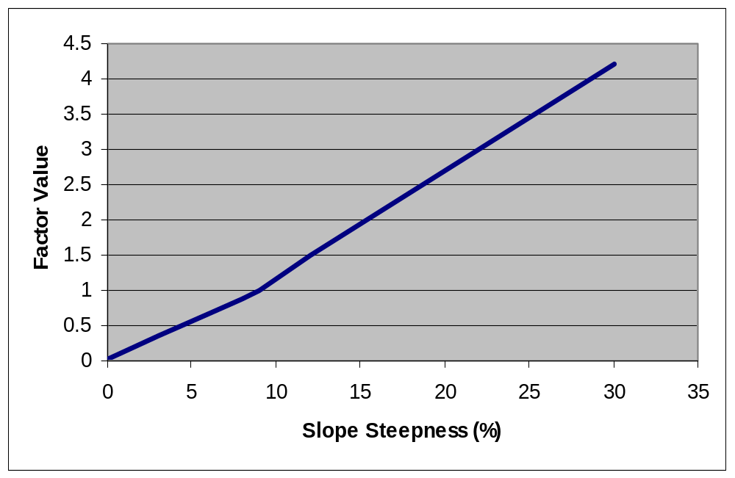
Detachment Proportional to Slope Steepness Factor
Not affected by any other variable
Notes:
This figure shows the slope steepness factor relationship used in RUSLE2. Detachment is proportional to the slope steepness factor. It is not a function of anything in contrast to the slope length factor.
However,in actuality the slope steepness is a function of the ratio of rill to interrill erosion but the science isn’t sufficient to develop a working relationship.

Slide 63
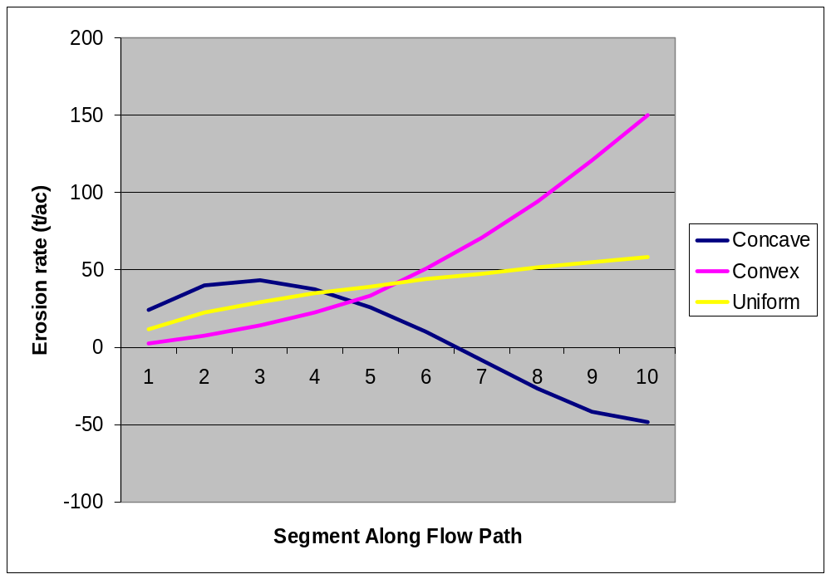
Effect of Slope Shape on Erosion
100 ft long, 1% to 19% steepness range
Notes:
This figure is a plot of soil loss values for different slope shapes.
The average steepness is the same for three slope shapes.
Values less than zero for the concave shape are deposition.
Note that maximum erosion rate on the concave slope is about the same for both the uniform and concave slope although sediment yield from the concave slope is much less than sediment yield from the uniform slope.
Note that maximum erosion rate for the uniform and convex slope occurs at the end of the slope.
Maximum erosion rate on the convex slope is much higher than maximum erosion rate on either the uniform or concave slopes.

Slide 64
Land Use
Cover-management
Supporting practices
Notes:
Two factor reflect the influence of land use in RUSLE2.
These factors are for cover-management and supporting practices.
Conservation practices are based on either cover-management and/or supporting practices.
Referring to supporting practices as conservation practices is improper. No-till is a wonderful conservation practice that works entirely though cover-management effects.

Slide 65
Cover-Management
Vegetative community
Crop
Crop rotation
Conservation tillage
Application of surface and buried materials (mulch, manure)
Increasing random roughness
Notes:
Cover-management is used in a variety of ways for erosion control and conservation practices.b

Slide 66
Supporting Practices
Contouring
Strip systems
  Buffer, filter, strip cropping, barriers
Terrace/Diversion
Impoundments
Subsurface drainage
Notes:
Supporting practices are primarily related to practices that affect transport capacity of runoff.

Slide 67
Cover-Management Subfactors
Canopy
Ground cover
Surface Roughness
Ridges
Below ground biomass
  Live roots, dead roots, buried residue
Soil consolidation
Antecedent soil moisture (NWRR only)
Notes:
RUSLE2 uses a set of subfactors to represent the effect of cover-management on erosion.

Slide 68
Cover-Management Effects
Raindrops intercepted by canopy cover
Raindrops not intercepted by canopy cover
Canopy cover
Intercepted rainfall falling from canopy cover
Ground cover
Ridges
Random roughness
Buried residue
Soil consolidation
Live roots
Antecedent soil moisture (NWRR)
Dead roots
Notes:
This schematic illustrates the position of each of the subfactor effects.
Some of the subfactors affect erosivity.
Some of the subfactors affect erodibility.
These subfactors are land use independent.
RUSLE2 uses equations to describe the effect of each subfactor and their interactions.
The equations have parameter values that are functions of the properties of the cover-management system, such as percent canopy.
Some of the effects of some subfactors are immediately obvious, while other effects are not.
For example, roots hold the soil in place, die, and add biomass to the soil. The effect that may not be obvious is that roots and their mass are an indirect indicator of plants removing soil moisture that in turn reduces runoff.

Slide 69
Canopy
Cover above soil surface that intercepts rainfall but does not touch soil surface to affect surface flow
Main variables
  Percent of surface covered by canopy
  Effective fall height
Notes:
Canopy cover is cover above the soil surface that only affects rainfall and not surface runoff.
Percent canopy and effective fall height are the two main variables used to describe canopy.
Percent canopy is 100 – Percent open space.
Open space includes the open space between the outside perimeters of individual plant canopies as well as open space with the perimeter of the canopy of a particular plant.

Slide 70
Effective Fall Height
Height to bottom of canopy
Gradient of canopy density
Material concentrated near top
Canopy height
Effective fall height
Notes:
Effective fall height is the single height that best represents the height from which reformed waterdrops fall from the canopy.
Fall height depends on maximum height of canopy, height to the bottom of the canopy, shape of the canopy, and gradient of the canopy material within the canopy (is the material concentrated at the bottom of the canopy or at the top?)

Slide 71
Ground Cover
Cover directly in contact with soil surface that intercepts raindrops, slows runoff, increases infiltration
Examples
  Live plant material
  Plant residue and litter
  Applied mulch
  Stones
Notes:
Ground cover is material directly in contact with the soil surface.
It affects both raindrop impact and surface runoff.
If placed on a mechanically disturbed (tilled) soil before any rainfall after the disturbance, ground cover can maintain high infiltration rates, which contributes to reduced runoff.

Slide 72
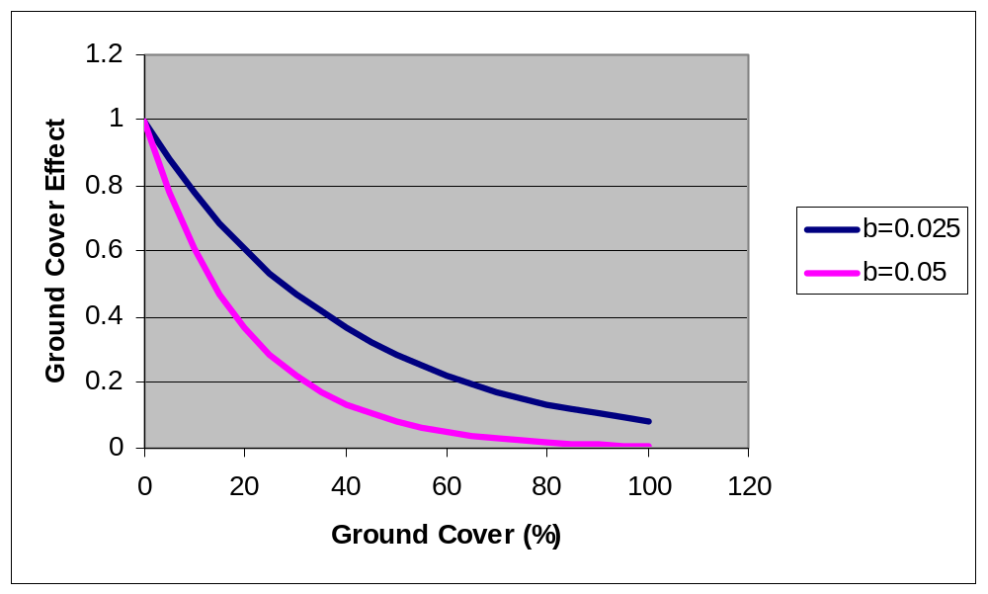
Ground Cover Effect
Eff = exp(-b x %grd cov)
b greater when rill erosion more dominant than interrill erosion
Notes:
Effectiveness of ground cover depends on the potential for rill erosion relative to interrill erosion.
Ground cover has a greater effect on rill erosion than on interrill erosion.
The equation Eff = exp(-b %grdcov) used to compute effect of ground cover.
The b value in this equations represents the relative effectiveness of ground cover—increased effectiveness means an increased b values.
Values for b range from 0.025 where interriill erosion is the dominant erosion to over 0.05 where rill erosion is dominant.
Example, b value is higher for steep slopes where rill erosion predominates than for flat slopes where interrill erosion predominates.
Value b is greater where increasing ground cover significantly increases infiltration.
Effectiveness of residue depends on contact between soil and ground cover. RUSLE2 assumes less effectiveness for conditions where soil loss biomass is low.
Effectiveness of residue on steep slopes is a function of type of residue. Rocks get more credit because of their contact with the soil than long pieces of mulch like un-chopped wheat straw.

Slide 73
Ground Cover
Live cover depends on type of vegetation, production level, and stage
Residue
  Amount added by senescence, flattening, and falling by decomposition at base
  Decomposition
    Rainfall amount
    Temperature
Notes:
Live ground cover is the the portion of the live aboveground plant material that is touching the soil surface.
This percent cover is not double counted by also including it with canopy cover.
It is a function of type of vegetation, production level, and stage of growth.
Residue is dead plant material. It is added to the soil surface by senescence, flattening by an operation like harvest or tillage, and falling as a result of decomposition at base.
Residue on the soil surface decomposes as a function of daily rainfall amount and temperature.
For example, the ground cover computed by RUSLE2 for no-till is significantly greater in Minnesota and than in Minnesota because of difference in rainfall and temperature, especially in the winter.

Slide 74
Interaction of Ground Cover and Canopy
Canopy over ground cover is considered to be non-effective
As fall height approaches zero, canopy behaves like ground cover
Notes:
As canopy approaches the soil surface, its effect becomes the same as ground cover.
Also, canopy above ground cover is given no credit. Effective canopy percent is reduced in proportion to the ground cover percent.

Slide 75
Random Roughness
Creates depressions
Usually creates erosion resistant clods
Increases infiltration
Increases hydraulic roughness that slows runoff, reducing detachment and transport capacity
Notes:
Random roughness is the roughness associated with the random peaks and depressions formed by mechanical disturbance.
It affects soil loss in a variety of ways.

Slide 76
Random Roughness
Standard deviation of micro-elevations
Roughness at tillage function of:
  Implement
  Roughness at time of disturbance and tillage intensity
  Soil texture
  Soil biomass
Decays with:
  Rainfall amount
  Interrill erosion
Random Roughness (in)
2.5
0
0
12
Range (in)
Notes:
Random roughness values range from 0 inches to about 3 inches, which represents a very rough surface.
Random roughness can be estimated by measuring the height from the bottom of the depressions to the top of the soil peaks.
Random roughness can be estimated by comparing the roughness of the given surface to photographs of surfaces having a known roughness value. See AH703
Random roughness can be measured by measuring micro-elevations with pins or with a laser.
Roughness at the time of creation is function of implement, tillage intensity, soil texture, and soil biomass.
Some implements create a rougher surface (moldboard plow versus a rototiller)
Tillage intensity refers to the extent that the roughness following an implement is related to the roughness at the time of tillage. A spike tooth harrow has a reduced tillage intensity (0.4) because it does not eliminate much roughness following a moldboard plow. A moldboard plow has a tillage intensity of 1 because it erases any sign of roughness existing at the time of tillage.
Soils high in clay produce increased random roughness, medium textured soils produce moderate roughness, and soils high in sand produced reduced roughness.
Increased roughness is computed for soils high in soil biomass, partly because of improved aggregation and stability. Values derived empirically from erosion data in AH537.

Slide 77
Ridges
Ridges up and downhill increase soil loss by increasing interrill erosion
Function of:
  Effect increases with ridge height
  Effect decreases with slope steepness above 6%
Ridge height decays with rainfall amount and interrill erosion
Effect shifts from increasing soil loss when up and downhill to decreasing soil loss when on the contour
Notes:
Ridge up and down increase soil loss.
Soil loss increases with ridge height up to about eight inches.
The increase in soil loss begins to decrease as land slope becomes greater than 6% and disappears by a land slope of about 20%.
Ridge height decays with rainfall and interrill erosion and thus the ridge effect decreases over time.
Effect ranges from about 1.5 (ridges increase soil loss from unit plot condition) for high ridges to about 0.9 for a flat surface.
Unit plot is assumed to have some ridge height, which is the reason for the 0.9 value.
Ridges on the contour reduce soil loss.
The effect of ridges increasing soil loss decreases as relative row grade decreases.

Slide 78
Dead Biomass Pools
Killing vegetation converts live standing to dead standing and live roots to dead roots
Operations
  Flatten standing residue to flat residue (ground cover)
  Bury flat residue
  Resurface buried residue
  Redistribute dead roots in soil
  Material spread on surface
  Material incorporated (lower one half of depth of disturbance)
Decomposition at base causes standing residue to fall
Notes:
RUSLE2 keeps of both live and dead biomass pools.
Live biomass pools are the live roots and the aboveground live growth.
Killing converts live biomass to dead biomass.
Operations shift dead biomass among pools (e.g. standing to flat, flat to buried, resurfacing of buried to flat)
Operations with soil disturbing effects bury residue and resurface buried residue.
Operations with soil disturbing effect redistributes residue and dead roots in soil.
Decomposition causes standing residue to fall over and become flat residue.

Slide 79
Decomposition of Dead Biomass
Function of:
  Rainfall
  Temperature
  Type of material
  Standing residue decays much more slowly
Notes:
Decomposition function of daily rainfall and temperature as driving mechanism.
Decomposition half lives (decomposition coefficients) assigned based on type of vegetation.
Standing residue decays more slowly than flat or buried residue.
Roots are assumed to decay at same rate as buried residue.

Slide 80
Below ground biomass
Live roots
  Distributed non-uniformly within soil
Dead roots
Buried residue
  Half of material decomposed on surface is added to upper 2 inches
  Incorporated biomass
Notes:
Mass of roots per unit depth increases in first three inches to a maximum and then decreases over a depth of 15 inches regardless of stage of growth or plant type.
Killing causes live roots to become dead roots and begin to decay.
A decrease of root biomass during year is assumed to be root sloughing and adds to the dead root pool.
Root sloughing causes a build up of biomass in the soil that is a function of location, more where decomposition is less.
A portion of the residue decomposed on the surface is arbitrarily added to soil biomass in upper 2 inches.

Slide 81
Effect of Below Ground Biomass
Roots mechanically hold the soil
Add organic matter that improves soil quality, reduces erodibility, increases infiltration
Affect rill erosion more than interrill erosion
Effect of roots considered over upper 10 inches
Effect of buried residue over upper 3 inches, but depth decreases to 1 inch as soil consolidates (e.g. no-till)
Notes:
Below ground biomass has several effects, many of them interactive with other effects such as soil consolidation.
The average amount of live and dead roots in 10 inches is the key variable for the effect of roots.
The amount of buried residue in the upper three inches is the key variable for the effect of buried residue.
The three inch depth is reduced as the soil consolidates to give greater credit to the build up of organic matter over time at the soil surface for no-till.

Slide 82
Soil Consolidation
Overall, freshly tilled soil is about twice as erodible as a fully consolidated soil
Erodibility decreases with time
  Seven years in the Eastern US
  Depends on rainfall in Western US, up to 25 years
Notes:
Mechanical disturbance of the soil such tillage increases soil erosion.
The increase is assumed to be almost double.
Some of the increase is usually offset by roughness.
Wetting and drying cycles increase soil resistance to erosion.
About seven years is the time assumed for soil to fully regain it resistance after tillage.
RUSLE2 computes a long time in the Western US as a function of rainfall.
The effect is greater for rill erosion than for interrill erosion.
The effect is related to soil texture, being less for coarse textured soils.
RUSLE2 doesn’t consider the textural effect.

Slide 83
Width of Disturbance
Width of disturbance taken into account in surface cover, random roughness, and soil consolidation
Notes:
Width of disturbance is important for strip type operations like planting, fertilizer and manure injections, row cultivation and subsoil.
The width is the width that the implement actually disturbs the soil, not the width that gets covered width “thrown” soil.

Slide 84
Antecedent Soil Moisture (NWRR)
Soil loss depends on how much moisture previous cropping systems have removed from soil
Notes:
The effect of antecedent soil moisture is especially important in the region known as the Northwest Wheat and Range Region (NWRR).
The effect is related to previous crops removing water from the soil resulting in higher infiltration rates and less runoff in subsequent periods.
Effect is important else but not explicitly represented.
NWRR is unique with its high erosion rates in the winter, partly caused by freezing and thawing and light rain on thawing soil, and reduced infiltration rates.
Soil is highly erodible in the NWRR during the winter.

Slide 85
Supporting Practices
Contouring/Cross-slope farming
Strips/barriers
  Rotational strip cropping, buffer strips, filter strips, grass hedges, filter fence, straw bales, gravel bags
Terraces/diversions
Impoundments
Notes:
Contouring relates to the direction of the tillage (ridges and furrows) with respect to the land slope.
Traveling around the slope such that the ridges are on the contour can significantly reduce soil loss for moderate slopes.
Cross slope farming is going at an angle to the direction of the land slope that is between being on the contour and up and down hill.
Cross slope farming reduces soil loss some but not nearly as much as contouring.
Strips and barriers slows runoff, reduce its transport capacity, and produce deposition.
Strips/barriers spread the runoff, reducing its erosivity.
Many type strips/barriers are used depending on land use.
Terraces/diversions are ridges-channels placed on the hillslope to intercept runoff.
In effect, terraces/diversions shorten slope length.
Terraces are channels on such flat grades that deposition occurs in them because transport capacity is less than incoming sediment load, provided the grade of the terrace channel is sufficient flat.
Diversions are design with a grade sufficiently steep that deposition doesn’t occur and with a grade sufficiently flat that erosion doesn’t occur.
Impoundments trap and retain runoff, giving sediment time to settle and be deposited.
Discharge for small basins can be discharged to an underground tile line thus eliminating concentrated flow at that point.
Storage of runoff in impoundments reduce flow rate, and thus reduce concentrated flow erosion.

Slide 86
Contouring/Cross Slope Farming
Redirects runoff
Fail at long slope lengths
Effectiveness depends on ridge height
  (no ridge height—no contouring effect)
Notes:
Contouring/cross slope farming redirects overland flow from a direct downhill path to a much less erodible one around the slope.
Contouring fails at long slopes.
Effectiveness of contouring directly tied to height of ridges and furrow grade.

Slide 87
Contouring/Cross Slope Farming (continued)
Function of:
  Ridge height
  Row grade
  Cover-management
  Hydrologic soil group
  Storm severity (10 yr EI)
Varies with time
  Tillage that form ridges
  Decay of ridges
Notes:
Over factors such as cover-management, hydrologic soil group, and storm severity affect performance of contouring by affecting runoff.
The effectiveness of contouring is almost entirely dependent on how it affects runoff.
The effectiveness of contouring varies through time as ridges are formed by tillage and as ridges settle and are eroded after tillage.

Slide 88
Critical Slope Length
If slope length longer than critical slope length, contouring fails allowing excessive rill erosion
Function of:
  Storm severity, slope steepness, cover-management, EI distribution
Critical slope length extensions below strips depend on degree that strip spreads runoff
Terraces are used if changing cover-management or strips are not sufficient
Soil disturbance required to restore failed contouring
Notes:
If runoff becomes to great on a slope with a particular steepness and cover-management condition, contouring will fail at a particular location on the slope (critical slope length) and lose its effectiveness for the portion of slope beyond critical slope length.
Erosion rates on this lower portion of the slope can be much greater than erosion rates on the remaining portion of the slope.
Thus, a conservation objective is not allow critical slope length to be exceeded, at least not for substantial amount of time during the rotation.
Critical slope can be increased by going to a cover-management system that leaves increased roughness and ground cover.
If critical slope length can not be increased sufficiently with cover-management, it sometimes can be increased by buffer strips that spread the runoff.
In difficult cases, terraces or a diversion are installed.
A soil disturbance (tillage operation) that forms ridges is required to restore lost contouring effectiveness lost by contour failure.

Slide 89
Buffer/Filter Strips
Narrow strips of dense vegetation (usually permanent grass) on contour
  Effective by inducing deposition (partial credit) and spreading runoff
  Most of deposition is in backwater above strip
Buffer strips
  Multiple strips
  Either at bottom or not a strip at bottom
  Water quality-must have strip at bottom and this strip twice as wide as others
Filter strip-single strip at bottom
Notes:
These strips are usually dense, permanent grass strips.
Also, very narrow stiff grass “hedges” are also used.
Should be placed as close to contour as possible for maximum effectiveness.
Otherwise runoff can flow along upper edge.
Buffer strips are multiple strips on a slope.
Last strip may or may not be placed at bottom of slope.
If the last strip is at bottom of slope, it acts as a “filter” and significantly reduces sediment yield.
A single strip at the bottom of slope is a filter strip.
Most of deposition is in the backwater above strip rather than in strip.
Strip spreads runoff so that it leaves the strip with reduced erosivity.
Only partial credit taken for deposition for protecting soil resource.
Almost no credit taken for protecting soil resource by a filter strip.

Slide 90
Rotational Strip Cropping
Equal width strips on contour
Strips are rotated through a crop rotation cycle
Offset starting dates among strips so that strips of close growing vegetation separate erodible strips
Benefit:
  Deposition (full credit)
  Spreading runoff
  Reduced ephemeral gully erosion not credited in RUSLE2
Notes:
A rotational system that starts with a crop rotation like corn-corn-hay-hay-hay.
Rotation is grown in strips so that the crops progress through the rotation on each strip.
Strips are alternated so that the more erodible strips are placed between less erodible strips.
Example: c-c-h-h-h
h-h-c-c-h
c-c-h-h-h
h-h-c-c-h
Full credit is taken for deposition that occurs with rotational strip cropping.
Dense vegetation strips spread runoff reducing its erosivity
System generally reduces ephemeral gully erosion.
Should be laid out very carefully to be on contour.

Slide 91
Terraces
Ridges and channels periodically placed along hillslope that divides hillslope into shorter slope lengths except for widely spaced parallel terraces that may have not effect on slope length
Benefit:
  Shorten slope length and trap sediment
  Runoff management system
Evenly spaced
  May or may have a terrace at bottom
Maintenance required to deal with deposition
Notes:
RUSLE2 assumes that terraces are equally spaced on the hillslope.
A terrace may or may not be bottom of slope.
A terrace at bottom of slope reduces sediment yield.
Parallel terraces do not shorten slope length as much as gradient terrace.
Special consideration should be given to how wide parallel terraces affect slope length.
Parallel terraces usually include an impoundment placed in concentrated flow area that parallel terraces cross.
Other benefits besides interrill-rill erosion control.

Slide 92
Types of Terraces
Contour line
Sediment basin into underground tile line
Parallel terrace
Grassed waterway
Gradient terrace
Notes:
Gradient terrace have uniform grade along them.
Spacing varies with gradient terraces because of nonuniform topography.
Generally discharge into grassed waterway to get runoff down slope without causing ephemeral gully erosion
Grade nonuniform along parallel terraces.
Have to be careful to avoid grade along parallel terraces being too steep.
Sediment basins usually used in conjunction with parallel terraces.
Typically discharge into underground tile line.
Main purpose of both systems is runoff management to control excessive rill erosion and especially ephemeral gully erosion.

Slide 93
Deposition in Terraces
Deposition occurs when sediment load is greater than transport capacity
Sediment load from sediment entering from overland area
Transport capacity function of grade and storm erosivity
Deposition depends on sediment characteristics
Deposition enriches sediment in fines
Notes:
For deposition to occur, sediment load must exceed transport capacity.
Deposition, including fraction of sediment load) in a terrace channel will be much less when little erosion occurs on inter-terrace interval.
Transport capacity decreases with grade of terrace channel and runoff rate in channel.
Deposition enriches the sediment load in fines.
The amount of deposition depends on the fineness of sediment coming into terrace channel.
For example, deposition will be less in a terrace where a grass strip immediately adjacent to the terraces induces significant deposition.
Maintenance required because of deposition. Otherwise terrace channels fill with sediment.

Slide 94
Diversions
Ridges and channels placed at strategic locations on hillslope to shorten slope length
  Reduce runoff rate and rill erosion
Generally designed with a steepness sufficiently steep that no deposition occurs but not so steep that erosion occurs
Notes:
Main purpose of diversions is to reduce runoff to control rill erosion.
Diversions are designed to neither deposit sediment or cause erosion.
Build up of deposition causes overtopping and failure.

Slide 95
Impoundments (Small sediment control basins)
Deposition by settling process
Function of:
  Sediment characteristic of sediment load reaching impoundment
Notes:
Main idea is to retain water sufficiently long for sediment to settle.
More effective at removing fines that other deposition on typical hillslope.
Only fines left in runoff.
Effectiveness highly dependent on the sediment distribution reaching basin.
For example, basin at end of channel where much deposition occurs much less effective.
Reduce runoff rate.

Slide 96
Sequencing of Hydraulic Elements
Hydraulic elements-channels and impoundments
Can create a system
Can put channels-impoundments in sequence
Examples:
  Tile outlet terrace—channel:impoundment
  Impoundments in series—impoundment:impoundment
Notes:
RUSLE2 allows sequencing channels and impoundments.
For example:
Terrace channel into impoundment-parallel terrace system.
Impoundments in series on a construction site to remove as much sediment as possible from runoff.

Slide 97
Benefit of Deposition
Depends on type of deposition
  Local deposition gets full credit
  Remote deposition gets partial credit
Credit for remote deposition
  Depends on location on hillslope
  Deposition at end gets almost no credit
Notes:
Benefit of deposition depends on type, amount, and location of deposition.
Local deposition gets full credit.
Remote deposition gets credit depending on location.
Almost no credit for deposition at end of slope.

Slide 98
Subsurface Drainage Systems
Reflects effects of deep drainage systems
  Tile drainage systems
  Lateral, deep drainage ditches
Describe by:
  Assigning hydrologic soil group for undrained and drained soil
  Fraction of area drained
Notes:
Values are assigned based efficiency and effectiveness of drainage systems.

Slide 99
Unit 5
Databases
  Worksheets
  Profiles
  Climate
  EI distribution
  Soil
  Management
  Operations
  Vegetation
  Residue
  Contouring
  Strips
  Diversion/terrace, sediment basin systems
  Sequence of hydraulic elements
Notes:
RUSLE2 uses a set of databases to store information.
The information is typically placed in the databases before making a soil loss computation.
Information in database can be added during a soil loss computation.
Information can be edited.
Access to databases in terms of what can be seen and edited can be controlled.
All of databases for RUSLE2 are housed in a single large database that be named and selected when RUSLE2 is being used.
Data can be imported from other RUSLE2 databases.
Data can be exported so that data can be shared among RUSLE2 users.
Data can be imported from RUSLE1 databases.
Names used in databases are arbitrary and only serve as identifiers.
When an identifier is selected, it brings the data associated with that identifier.

Slide 100
Profiles
Central part of a RUSLE2 soil loss estimate
  Profile is reference to a hillslope profile
Five things describe a profile
  Location, soil, topography, management, supporting practice
  Topography described with segments
  Can specify segments by length and steepness for topography, segments by length for soil, segments by length for management
Name and save with a name
Notes:
Profiles correspond to overland flow paths along hillslope profiles.
The profile is along the overland flow path when the surface is smooth without ridges affecting flow direction.
The flow path is the direction of maximum gradient along the hillslope.
Location, soil, topography, management, supporting practices, and hydraulic element system describe a profile.
The profile is the core of the RUSLE2 representation.
RUSLE2 represents a single, unique hillslope profile in each of its computations.
Multiple RUSLE2 computations are made to represent to represent a complex area where values from each profile are weighted to obtain an estimate for the area.
The profile describes the topographic shape along the overland flow path.
Profiles can be named, saved, and reused.
Example: making multiple computations to evaluate alternative managements.
First step in learning RUSLE2 should be in making soil loss computations with profiles.

Slide 101
Worksheets
Three parts: Alternative managements, practices; Alternative profiles; Profiles for a field or watershed
Alternative management, practices
  Compare alternatives for a single hillslope profile
Alternative profiles
  Compare specific hillslope profiles
Name and save worksheets
Notes:
Major routine working tool with RUSLE2.
Compare alternatives for the same base profile
Compare profiles
Compute weighted values for a field, region, or watershed based on areas represented by each profile.
Name, save, and reuse worksheets.

Slide 102
Plan View
Profiles for a field or watershed
Field/Watershed
  Compute weighted average soil loss/sediment yield for a field or watershed
Name and save plan views

Slide 103
Concept of Core Database
RUSLE2 has been calibrated to experimental erosion data using assumed data values for such things as cover-mass, residue at harvest, decomposition coefficient, root biomass, burial ratios, etc.
The data used in this calibration are core calibration values
  Data used in RUSLE2 applications must be consistent with these values
Core databases were set up for vegetation, residue, and operations
  NRCS data manager maintains these databases
Working databases developed from the core databases
Notes:
Concept critically important.
Must follow the rules of using core databases to get good results from RUSLE2.
Data for many variables are linked.
RUSLE2 has been calibrated to give good soil loss values based on research data assuming a certain set of input values.
The input values used in application of RUSLE2 must be consistent with the calibration values.
Core values have been set up to be consistent with the calibration values.
A change away from the core values actually degrades the performance of RUSLE2 rather than improves it.
RUSLE2 DEFINITIONS, RULES, PROCEDURES, and CORE DATA MUST BE FOLLOWED FOR GOOD RESULTS.
Can’t independently change one set of data without recalibrating.
Must let RUSLE2 factors and subfactors represent what they were intended to represent.
For example, the K factor values are not to be modified to represent the effect of organic farming. The cover-management subfactors represent the effects of organic farming.

Slide 104
Critical RUSLE2 Rules
RUSLE2 DEFINITIONS, RULES, PROCEDURES, and CORE DATA MUST BE FOLLOWED FOR GOOD RESULTS.
Can’t independently change one set of data without recalibrating.
Must let RUSLE2 factors and subfactors represent what they were intended to represent.
  For example, the K factor values are not to be modified to represent the effect of organic farming. The cover-management subfactors represent the effects of organic farming.
Don’t like these rules—then don’t use RUSLE2 because results won’t be good.
Notes:
The importance of the core database concept and following these rules is essential!

Slide 105
Climate
Input values for values used to described weather at a location, county, management zone
Principal values
  Erosivity density value, 10 yr 24 hr precip, monthly precip, monthly temperature
Designate as Req zone and corresponding values
Data available from NRCS
Name and save by location, county average, or precip zone
Notes:
The climate database stores the weather data needed to make a RUSLE2 soil loss computations.
Best of source of data is from NRCS.
Seek out their data and store only the data that will be used in RUSLE2 application. No point having data in database that will never be used.

Slide 106
Soil
Data describes base soil conditions for unit plot conditions
Data include erodibility value, soil texture, hydrologic soil group of undrained soil, hydrologic soil group of drained soil, time to full soil consolidation, rock cover
Erodibility nomograph available to estimate soil erodibility factor K
Data available from NRCS soil survey database
Name and same
Notes:
Try to use NRCS data if possible.
Use the erodibility nomograph for severely disturbed conditions.
Be alert to special soil conditions such as volcanic soils.
Don’t apply RUSLE2 to organic soils.
Remember, data are for unit plot condition. RUSLE2 cover-management factor takes into account differences between actual field condition and unit plot conditions.

Slide 107
Management
Array of dates, operations, vegetations
Specify if list of operations is a rotation
  Rotation is a cycle when operations begin to repeat
  Rotations used in cropping
  Rotations often not used immediately after land disturbances like construction and logging during recovery period
  Length of rotation
Yield, (depth and speeds of operations optional)
Added materials and amounts
NRCS databases, Extension Service
Name and save
Notes:
Management has more effect on soil loss rather than other factor.
Description of a management is a list of dates, operations that occur on each date, and the vegetations associated with an operation that has a “begin growth” effect and the residue associated with an operation that has an “adds other cover” effect.
Specific operations, vegetations, and residues are selected from lists for those already in databases.
If required information is not already in database, then a specific entry will have to be edited or a new entry made.
Access to database may be limited and not available to particular users. Check with your supplier of RUSLE2.
In general, accept values in database because of the research and judgment gone into the preparation of databases by researchers, NRCS technical specialists, and technical specialists from other organizations.
However, dates and operations should be reflective of local conditions.
Consistency among RUSLE2 applications is critically important.
Be careful about trying to modify variables like yield, depth, and speed to exactly the field conditions. Changes in estimated soil loss may not be meaningful and significant for small changes.
Rotations are a cycle where operations begin to repeat.
A rotation can be one year.
A rotation can include multiple crops (vegetations).
A management can include volunteer vegetation (weeds) in addition to planted crops.
RUSLE2 is dumb. Weeds must be in vegetation database and an operation must be present to get the weeds to grow, and then an operation must be present to stop weed growth. The same applies to all vegetations.
RUSLE2 only “sees” one vegetation at a time. The information in a vegetation file must reflect the overall conditions at the time.
For example, RUSLE2 can combine the information for small grain and a legume to know what is in the field. The user must provide values for the combined condition and specifically name and save that vegetation.
NRCS and Extension Service good source of information for cropland. Consult other NRCS and other agencies like Bureau of Land Management for range for other land uses.

Slide 108
Operations
Operations describe events that change soil, vegetation, and residue conditions
Mechanical soil disturbance, tillage, planting, seeding, frost, burning, harvest
Describe using effects and the sequence of effects
Speed and depth
Source of data: Research core database, NRCS core database, working databases
Name and save
Notes:
Operations are events that change the soil, vegetation, or residue.
Typically human activity, but can animal, like grazing removing aboveground biomass, or natural like frost killing vegetation.
Operations are described with effects.
Sequence of effects critical.
Stick with the NRCS database.
If new new operations, must be created, follow the NRCS core database for cropland. Consult with RUSLE2 developers for core data for other land uses.

Slide 109
Operation Effects
No effect
Begin growth
Kill vegetation
Flatten standing residue
Disturb surface
Live biomass removed
Remove residue/other cover
Add other cover
Add nonerodible cover
Remove nonerodible cover
Notes:
These are effects used to describe operations.

Slide 110
Operation Effects (cont)
No effect
  Primarily used to obtain output at particular times or to add fallow years when not operation occurs in that year
Begin growth
  Tells RUSLE2 to begin using data for particular vegetation starting at day zero
  Typically associated with planting and seeding operations
Kill vegetation
  Transfers mass of above ground live vegetation into standing residue pool
  Transfers mass live roots into dead root pool
  Typically used in harvest and plant killing operations

Slide 111
Operation Effects (cont)
Flatten standing residue
  Transfer residue mass from standing pool to flat, ground surface pool
  Based on a flattening ratio that is a function of residue type
  Used in harvest operations to determine fraction of residue left standing after harvest
  Used in tillage and other operations involving traffic to determine fraction of residue left standing after operation
Notes:
Key point:
No residue gets flattened unless it falls by decomposition at the base of the residue or an operation is used to flatten the residue.
The flattening effect is used at harvest to determine how much of the aboveground biomass is left standing.
Only “dead” aboveground biomass can be flattened.
Flattening ratio values are based on process used to flatten and the type of residue.
Standing residue of some vegetations are more easily flattened than with other vegetations.
Based on mass.
Follow core databases.

Slide 112
Operation Effects (cont)
Disturb surface
  For mechanical soil disturbance that loosens soil
  Tillage type (inversion, mixing+some inversion, mixing only, lifting fracturing, compression) determines where residue is placed in soil and how residue and roots are redistributed within soil
  Buries and resurfaces residue based on ratios that depend on residue type
  Tillage intensity (degree that existing roughness is obliterated)
  Recommended, minimum, maximum depths
  Initial ridge height
  Initial, final roughness (for the base condition)
  Fraction surface area disturbed (tilled strips)
Notes:
Critical effect for representing tillage and other soil disturbing operations.
Burial and resurfacing ratio values function of implement and type of residue.
These ratios based on mass.
Tillage intensity represents how much of the existing roughness at time of disturbance influences roughness after the disturbance. A harrow does not eliminate all existing roughness (tillage intensity= 0.4). The roughness left by a moldboard plow is independent of preexisting roughness (tillage intensity = 1.0).
Follow core database.

Slide 113
Operation Effects (cont)
Live biomass removed
  Fraction removed
  Fraction of that removed that is “lost” and left as ground cover (flat residue)
  Used with hay and silage harvest operations
Remove residue/other cover
  All surface residues affected or only most recent one?
  Fraction of standing cover removed
  Fraction of flat cover removed
  Used in baling straw, burning operations

Slide 114
Operation Effects (cont)
Add other cover
  Fraction added to surface versus fraction placed in soil
  Unless all mass added to surface, must be accompanied by disturbed soil effect (that is, mass can not be placed in soil without disturbance)
  Mass placed in soil is placed between ½ and maximum depth
  Used to add mulch and manure to surface, inject manure into soil
Notes:
Use to apply mulch.
Use to surface apply manure.
Use to inject manure.
Subsequent operations bring some of the manure to surface.
The amount applied is in terms of dry weight of organic material.
Rock can be applied to soil surface and treated as a residue with essentially a zero decomposition coefficient.
Refer to NRCS core database for properties of different types of manure.

Slide 115
Operation Effects (cont)
Add nonerodible cover
  Erosion zero for portion of surface covered
  Cover decays over time
  Used with plastic cover, water cover, snow cover to eliminate erosion
Remove nonerodible cover

Slide 116
Vegetation
Live plant material
Static variables include:
  Residue name, yield, retardance, senescence, moisture depletion for NWRR
Time varying variables
  Root biomass in upper 4 inches
  Canopy cover percent
  Fall height
  Live ground (surface) cover cover percent
Source of data: Research core database, NRCS core database, working databases
Name and save
Notes:
RUSLE2 considers that only one vegetation is growing at a time.
Values in database must describe the conditions when this vegetation is present.
RUSLE2 can not combine data from one vegetation and another vegetation to produce a composite vegetation.
An example is intercropping and the understory of grass under shrubs on rangeland.
Try to use time varying root biomass values to account for root sloughing so that RUSLE2 can compute a buildup of biomass in the soil.
Use time varying canopy values where canopy values decrease to represent senescence and RUSLE2 can compute a litter layer on the soil surface.
Follow core databases.
Review data from multiple studies and observations before selecting values. Variability is large. Don’t rely on data from a single source. RUSLE2 is designed to represent main effects in a consistent way across applications.

Slide 117
Yield-Residue Relationship
Residue at max canopy function of yield
Residue at Max Canopy
Residue 2
Residue 1
Yield 1
Yield 2
Yield
Notes:
RUSLE2 computes residue at maximum canopy as a linear function of yield. The result is that the typical residue to yield ratio increases as yield decreases.
Key point: It is the residue at maximum canopy that is described. Not residue at harvest. RUSLE2 computes residue at harvest.
Two data points are entered to describe relationship.
One check is to consider the residue at zero yield.
Vegetation like corn can have residue at zero yield.
Vegetation like grass would not have a residue at zero yield.

Slide 118
Yield-Retardance Relationship
Retardance function of yield, on contour, and up and down hill
Retardance
Retardance at a high yield
Significant retardance at no yield (wheat)
No retardance at no yield (grass)
No retardance at a significant yield (corn)
Yield
Notes:
Retardance refers to how vegetation and its standing residue slow runoff.
Two data points are used to describe the curve. One data is the retardance at a high yield.
The other data point from one of three conditions is used.
Condition 1: The vegetation has no effect at a low yield, which is the situation for the lowest curve in figure. An example is that the retardance for corn is assumed to be zero at about 100 bu/ac.
Condition 2: The vegetation has no retardance at a zero yield, which is the middle curve. An example is grass.
Condition 3: The vegetation has retardance at a zero yield, which is the upper curve. An example is small grain like wheat.
Retardance is described in two directions, on the contour and up and downhill. The retardance relationship in the above figure is used to describe retardance on the contour.

Slide 119
Retardance for Up and Downhill
RUSLE2 chooses retardance based on row spacing and the retardance selected for a strip of the vegetation on the contour
  How does vegetation slow the runoff?
Row spacing
  Vegetation on ridge-no retardance effect
  Wide row-no retardance effect (> 30 inches spacing)
  No rows, broadcast-same as strip on contour
  Narrow row-small grain in about 7 inch spacing
  Very narrow-same as narrow row except leaves lay in row middle to slow runoff
  Moderate-about 15 to 20 inches spacing
Notes:
Setting this value sets a retardance in relation to retardance in a strip.
Ask the question, to what degree does vegetation in rows up and downslope slow the runoff?

Slide 120
Long Term Vegetation
Constructs growth data
Starts from zero and evolves to mature condition
Data varies in a cyclic pattern
Timing of pattern can be varied
Ratios of annual root biomass production to above ground annual biomass available in program for several rangeland plant communities

Slide 121
Residue
Size, toughness
  5 types: small, fragile (soybeans); moderate size, moderately fragile (wheat); large size, nonfragile (corn); large size, tough (woody debris); gravel, small stones
Decomposition (coefficient, halflife)
Mass-cover values
Source: NRCS databases
Name and save
90%
Enter 1 of 3 pts.
Mass @ 30, 60, or 90% cover
% Cover
60%
30%
0
0
Mass per unit area
Notes:
Several variables are used to describe residue.
Size and toughness, replaces the fragile, non-fragile concept.
5 types defined.
Decomposition is a function of distribution of stems, leaves, pods, roots, etc. but a single value is used.
Also a single value is used for above ground and below ground decomposition.
Mass-cover relationship. Enter a data point on curve. RUSLE2 self-calibrates.
Stay with core values in core databases. Interaction of mass-cover, residue at harvest and decomposition. Change of one requires recalibration of RUSLE2.
RUSLE2 captures main effects.

Slide 122
Senescence
Input the fraction of the biomass at max canopy that falls to soil surface when canopy decreases from its max value to its min value.
Input the minimum canopy value that corresponds to fraction that experiences senescence
Mass that falls is computed from difference in canopy percentages and nonlinear relationship between canopy percent and canopy mass
Notes:
Decrease in canopy percentage is used to compute amount of residue that falls to soil surface as a part of senescence.
The input fraction is the fraction of the biomass existing at max canopy that will fall to the surface when the canopy cover decreases from its maximum value to a minimum value that is also input.

Slide 123
Contouring/Cross Slope Farming
To have contouring, must have ridge heights
  To have ridge height, must have operation
  Ridge height assigned in operation
Row grade
  Relative row grade (preferred) or absolute
Create contouring practices based on relative row grade (row grade/land slope)
  Perfect (0%), exceeds NRCS specs (5%), meets specs (10%), Cross slope (25%), Cross slope (50%)
Name and save contouring practice
Notes:
Contouring practice that is named and saved only saves a row grade.
The other part of the contouring description is the ridge heights described in the soil disturbance effect used to describe operations.
Remember: no ridges-no contouring effect. To increase contouring effect, reduce row grade and increase ridge height.
An operation is required to create a ridge height.

Slide 124
Strips/Barriers
Types
  Filter, buffer, rotational strip cropping
Filter
  Specify width and management on strip
Buffer
  Specify number, whether strip at bottom, for erosion or water quality control, width, strip management
Rotational strip cropping
  Specify number, timing of rotation on each strip
Name and save
Notes:
Note: The profile view can used to specify custom strip systems.
For example, where strip width, spacing, and management vary by strips.
This description is primarily routine conservation planning.

Slide 125
Hydraulic Elements and Their Sequence
Channels
  Specify grade
Impoundments
  Nothing to specify
Specific order of elements
Name and save sequence
Notes:
RUSLE2 uses two types of hydraulic elements.
Channels (terraces and diversions) and impoundments (sediment control basins).
Elements can be used by themselves or combined into systems.

Slide 126
System of Hydraulic Elements
System composed of named sequence of hydraulic elements
Number of systems on overland flow path
Is the last one at the end of the overland flow path?
Name and save systems
Notes:
A simple system is a gradient terrace where a single channel is used. Choose a channel with the appropriate grade and drains external to area.
A simple sediment control basin is the combination of an impoundment that drains external.
Sediment basins in series is an impoundment that drains to another impoundment.
A simple PTO terrace is an overland area that drains to a channel that in turn drains to an impoundment.

Slide 127
Subsurface Drainage Systems
Represented by:
  Hydrologic soil group for soil when it is well drained
    Entered in soil input
  Fraction of area that is drained
Name and save
Notes:
The types of subsurface drainage that is represented are those that are deep drained by tiles or by deep lateral ditches.
Main effect is how drainage system affects runoff, which is represented by inputting values for two hydrologic soil groups, one when no drainage system is present and the other is when the a highly efficient system is used.
The fraction of the area relates to the fraction of the area where the soil loss is being computed that is treated with the drainage system. For example, a low value for the fraction drained would be entered where only wet spots are drained.

Slide 128
UNIT 6
Applicability
Notes:
This section deals with general information about RUSLE2 that should be considered when RUSLE2 is being applied.
Where does RUSLE2 work best?
What is the accuracy of RUSLE2?
How sensitive is RUSLE2 to certain variables?

Slide 129
LIMITS OF APPLICABILITY
How well does RUSLE apply to this situation?
  Erosion Processes
  Land Uses
  Geographic Regions
  Temporal Scale
  Uncertainty in computed values
Notes:
RUSLE2, like all hydrologic models has its limitations.
How well does RUSLE2 work for these situations?
RUSLE2 is applied well beyond the central research data used to derive it.
When do conditions become such that RUSLE2 should not be used?

Slide 130
APPLICABLE PROCESSES
Yes: Interrill and rill erosion
Yes: Sediment yield from overland flow slope length
Yes: Sediment yield from terrace channels and simple sediment control basins
No: Ephemeral or permanent incised gully erosion
No: Stream channel erosion
No: Mass wasting
Notes:
RUSLE2 estimates sediment yield and sediment characteristics from overland slopes, low grade terrace type channels, and small sediment basins.
RUSLE2 sediment yield estimates are not estimates of sediment yield from fields unless the slope length ends at the edge of field.
Remember: RUSLE2 is designed to capture main effects.
RUSLE2 should be used to design sediment basins or channels.
RUSLE2 does not estimate ephemeral gully erosion. While ephemeral gully erosion within field sized areas is a critical element in conservation planning, the benefits of controlling ephemeral gully erosion are not explicitly considered in RUSLE2.
Also, runoff management and disposal from field-sized areas is critically important. RUSLE2 is not designed to determine all of the benefits of runoff management in a field-sized area, even though it is a critically important part of conservation planning.

Slide 131
Applicable Land Uses
All land uses where overland flow and interrill-rill erosion occurs
Land use independent
Best: Cropland
Moderate: Disturbed lands like military lands, construction sites, landfills, reclaimed lands
Acceptable: Rangelands, disturbed forestlands, parks and recreational areas
Notes:
RUSLE2 estimates the erosion, deposition, and sediment transport associated with overland flow. It does not, for example, estimate erosion by piping from flow internal in the soil.
RUSLE2 is designed to be land use independent.
RUSLE2 IS NOT A CROPLAND EROSION PREDICTION TOOL.
IT WORKS FOR ALL LANDUSE WHERE EROSION OCCURS IN ASSOCIATION WITH OVERLAND FLOW.
RUSLE2 works better on some land uses than on other land uses because of the availability of data to derive parameter values. Also, it does less on some land uses than other because of spatial variability of cover-management conditions, such as on some disturbed forestland.

Slide 132
Cropland Applications
Best: Clean tilled corn, soybean, wheat crops
Moderate: Conservation tillage, rotations involving hay
Acceptable: Hay, pasture
Most variable: Support practices, especially contouring
Notes:
RUSLE2 does least well for contouring that for any other factor because of variability with implement operation and with specific conditions at specific storms.

Slide 133
MOST APPLICABLE GEOGRAPHIC REGIONS
Rainfall occurs regularly
Rainfall predominant precipitation
Rainfall exceeds 20 inches
Northwest Wheat and Range Region (NWRR) special case
West problem area because of infrequent storms and snow cover in higher elevation
Notes:
RUSLE2 works best for the eastern US because of the mass of data and the regularly occurring rainfall.
RUSLE2 IS NOT A MIDWESTERN BASED EROSION PREDICTION TECHNOLOGY. IT IS LOCATION INDEPENDENT EXCEPT FOR THE RELATIONSHIPS USED IN THE NWRR.

Slide 134
APPLICABLE SOILS
Best: Medium Texture
Moderate: Fine Texture
Acceptable: Coarse Texture
NO: Organic
Notes:
RUSLE2 should not be applied to organic soils.
Works best for silt loam soils because of the large amount of empirical data.
Works poorest for coarse textured soils because of the greater role of infiltration on runoff.

Slide 135
APPLICABLE TOPOGRAPHY
Slope Length
  Best: 50 - 300 feet
  Moderate: 0 - 50 ft , 300 - 600 ft.
  Acceptable: 600 - 1000 feet
  NO: >1000 feet
Notes:
The range of applicability is determine by the availability of empirical data.
RUSLE2 should not be applied to slope lengths longer than 1000 ft. The longest slope length used derive RUSLE2 was about 650 ft. Beyond 1000 ft is simply too much extrapolation.
RUSLE2 can be applied to slope lengths as short as 1 ft.

Slide 136
APPLICABLE TOPOGRAPHY
Slope Steepness
  Best: 3 - 20%
  Moderate: 0 - 3%, 20 - 35%
  Acceptable: 35 - 100%
  NO: >100%
Notes:
RUSLE2 should not be applied to slopes greater than 100%. Other processes like mass movement become a factor, something not represented by RUSLE2.
Almost no data for steepness greater than 30%.

Slide 137
UNCERTAINTY
Confidence in Result
Best (±25%): 4 < A < 30 t/ac/yr
Moderate (±50%): 1 < A < 4
30 < A < 50
Least (>±100%): A < 1
(>±50%): A > 50
Notes:
The range where soil erosion prediction technology needs to be accurate is from about 1 tons/acre to about 15 tons/acre for conservation planning for protecting the soil against excessive erosion.
Anything less than 1 tons/acre is already below almost all soil loss tolerance values and thus erosion is problem.
Anything greater than about 15 tons/acre (three times soil loss tolerance) is going to be recognized as being serious erosion problem regardless of the whether the estimate is 15, 25, or 40 tons/acre.
The critical concern is does the technology accurately distinguish in recommending to a farmer that the proposed management practice will take soil loss from 10 tons/acre to 5 tons/acre.
Accuracy for high soil loss estimates is important when sedimentation is important, such as the amount of sediment that will be trapped in sediment control basins, the amount of sediment that will be collected in roadside ditches, and the amount of sediment delivered to a stream.
Accuracy of low soil loss estimates and sediment characteristics are important in water quality analysis.
When all is said and done, no other erosion prediction has been demonstrated to perform better than RUSLE2 for day in and day out conservation planning at the field office level.
Certain technologies are far more powerful than RUSLE2 for evaluating the performance of sediment control basin and erosion control structures used on severely disturbed land.
Also, RUSLE2 does not apply to complex watershed for computing sediment delivery.
However, when properly used, RUSLE2 is a proper (and best) tool for estimating interrill and rill erosion on large complex areas like in the USDA NRI.

Slide 138
Significant Change
Rule of thumb:
  A change in a RUSLE2 soil loss estimate by more than 10% is considered significant and meaningful in terms of representing main effect.
  An change less than 10% is not considered significant in general
The accuracy for RUSLE2 representing how main effects affect soil loss is much better than the absolute accuracy for RUSLE2 estimating soil loss at any particular location and landscape condition.

Slide 139
TEMPORAL APPLICABILITY
Best: Average annual, average annual season, average annual single day
Least: Single storm provided great care used, generally not recommended
Notes:
While RUSLE2 is not recommended for application to single storms, it can be and is occasionally applied for single storms.

Slide 140
Sensitivity
Change in soil loss per unit change in a particular variable
Select a base condition
Vary input values for a variables about base condition
Sensitivity varies according to condition
Variables with greatest sensitivity require greatest attention
Notes:
Sensitivity analysis are very useful for understanding how RUSLE2 works.
Sensitivity can help determine the key variables in certain situations.
Sensitivity analysis have to be conducted with considerable care because the results depend on the situation.
For example, depth of tillage with a tandem disk may be unimportant when it follows a moldboard plow but very important if it is the first operation after harvest.
Another example, residue cover at planting, especially for clean-tilled and mulch till systems. Varying residue cover at planting doesn’t always have as much effect as expected because of the effect of other variables over the course of the rotation.
Many variables in RUSLE2 are interrelated, such as how yield affects soil loss.
Nevertheless, the variables that have the greatest effect on soil loss should be considered most carefully.

Slide 141
Examples of Sensitivity
Some variables have a linear effect
  Erosivity factor R
  Slope steepness
Effect of most variables is nonlinear
  Ground cover
  Below ground biomass
  Roughness
Notes:
Some variables like the erosivity factor and the steepness factor have a linear effect in RUSLE2. Double the variable; double the effect.
Most variables have a nonlinear effect such that doubling variable has more or less than a doubling effect on soil loss.

Slide 142
Examples of Sensitivity (cont)
Low sensitivity
  Slope length at flat slopes (0.5%) A= 4.6 t/a at λ = 150 ft, 5.2 t/a at λ = 500 ft, 5.5 t/a at  = 1000 ft
Moderate sensitivity
  Slope length at steep slopes (20%) A = 129 t/a at λ = 50 ft, A = 202 t/a at λ = 100 ft, A = 317 t/a at λ = 200 ft.
Notes:
These results how sensitivity to a variable depends on the situation and illustrates how one need not be concerned with estimating a variable under one condition but give much greater care under another condition.
For example, being off in slope length by 850 ft didn’t have much effect on a 0.5% slope, but being off just 50 ft had a tremendous effect on a 20% slope.

Slide 143
Examples of Sensitivity (cont)
High sensitivity-Ground cover single most important
  Adding mulch
Most variables interrelated
  Ground cover at planting not as much as expected
Sequence of operations
  Effect of depth for a tandem disk
  Depends on whether proceeded by moldboard plow

Slide 144
SUMMARY
RUSLE varies in its applicability
Results from RUSLE must be judged
Degree of confidence in results varies

